Slide 1

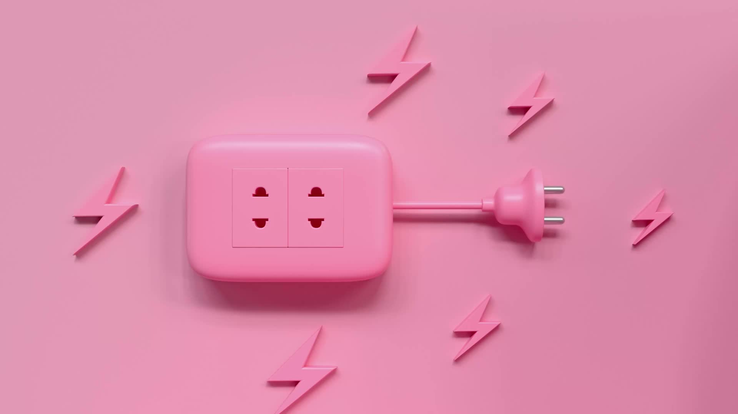
Electricity
Basic Terms

Slide 2

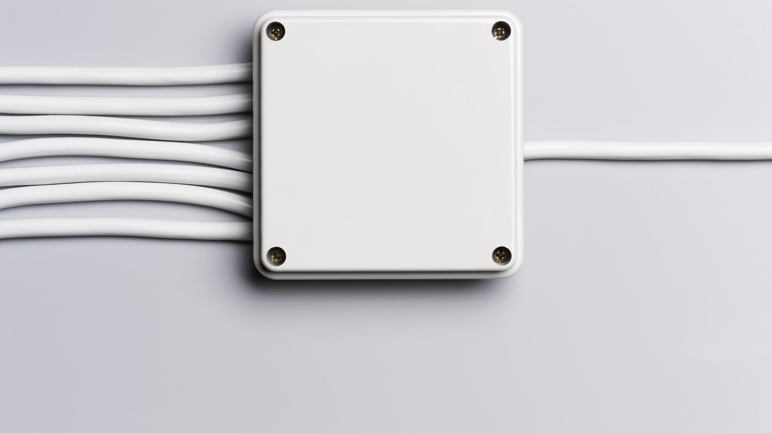
Electric Current
Electric current results when electric charges move - these may be negatively charged electrons or positive charge carriers - positive ions.

Slide 3

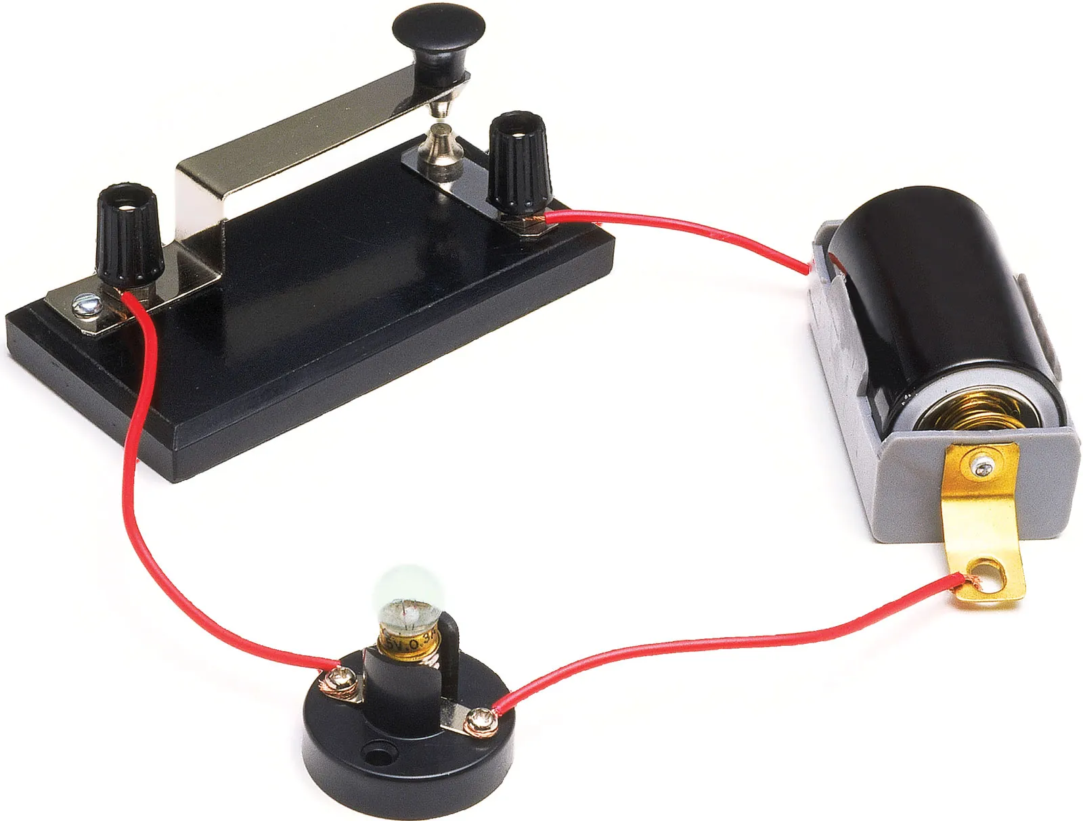
A simple electric circuit
This is a simple electric circuit. A cell provides an electric current. This flows through wires which conduct the electricity. The current is used to light a lamp.
So, like all circuits, the example includes an electrical supply (in this case the cell), an electrical conductor, and one or more electrical components – electrical devices (in this case the lamp) which have a function.

Slide 4
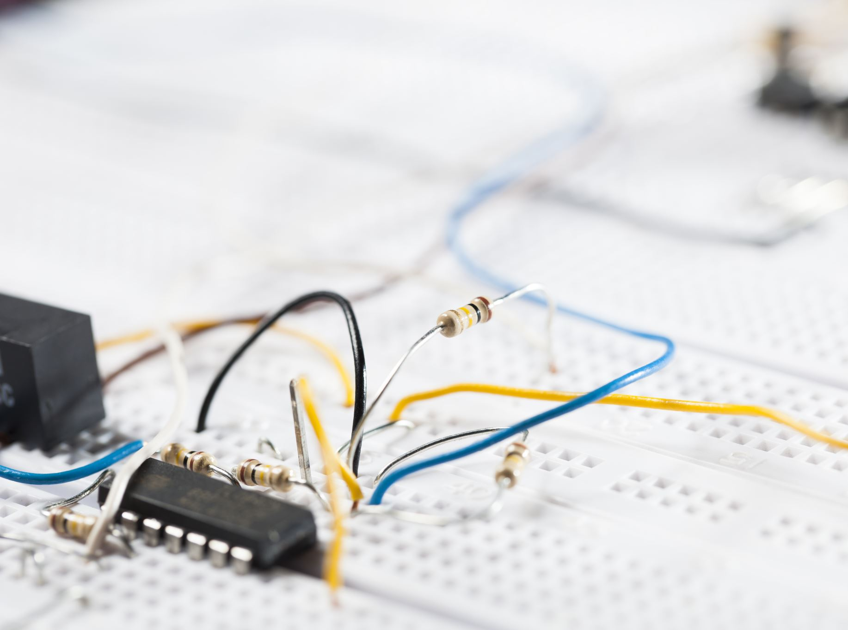
Current
Current is measured in amperes or amps (A) and is the rate of flow of electrical charge. Electric charge is carried by electrons – particles with a negative charge – which are normally attached to atoms.
Note – In everyday English, cells are called batteries. In technical English a battery is a number of cells placed together.
Lamps are usually called bulbs in everyday English

Slide 5
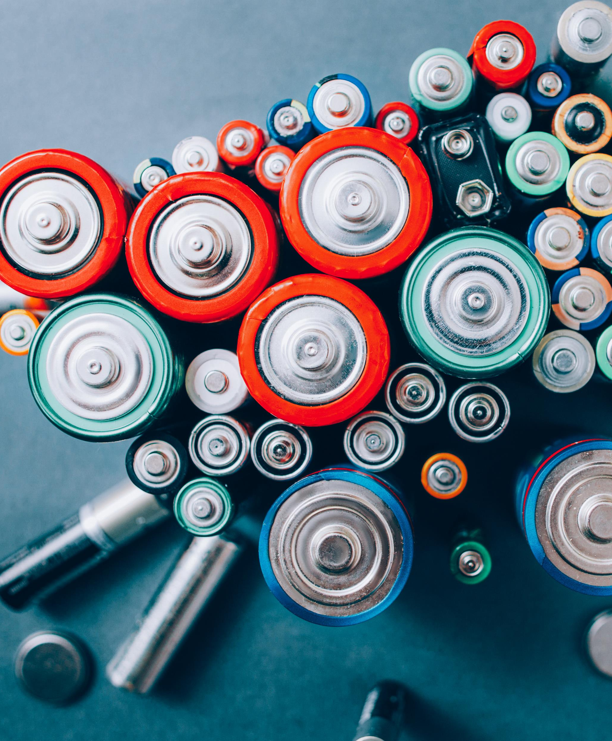
Voltage and Resistance
The amount of current (in amps) flowing through a circuit will partly depend on the electromotive force (EMF) of the electrical supply. Electromotive force is measured in volts (V) and is generally called voltage. The voltage depends on the strength of the electrical supply.

Slide 6
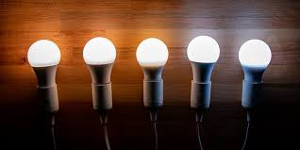
…continued
The amount of current will also depend on electrical resistance. This value in ohms (Ω) is a measure of how easily current can flow through the conductors and components in a circuit.
For example, a lamp creates resistance because the filament – the metal wire inside it – is very thin. This limits the amount of current that can flow. Resistance also depends on the materials used as conductors.

Slide 7

Insulators
Materials with very high resistance, such as plastics are called electrical insulators. Only very high voltages cause current to flow through them. Materials that are very good insulators are used to insulate conductors. An example is plastic insulation around electric wires. This stops a live wire from giving an electric shock to someone.

Slide 8
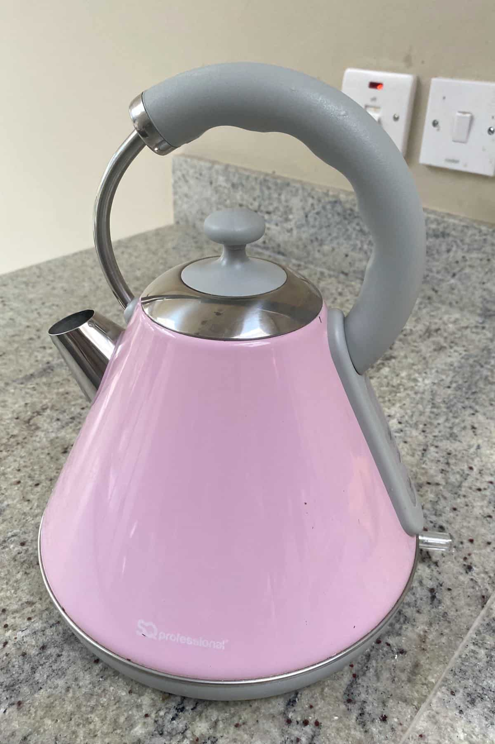
Domestic Electrical Power
The amount of current in amps, required by an electrical appliance – such as a TV or an electric kettle – depends on the power of the appliance. This number – expressed in watts (W) will be marked somewhere on the appliance. To calculate the required current, simply take the wattage and divide it by the voltage of the electrical supply in your home – around 230 volts in most of Europe. Therefore, for an electrical kettle with a power rating of 2,000 watts, the current required is 8.7 amps.

Slide 9
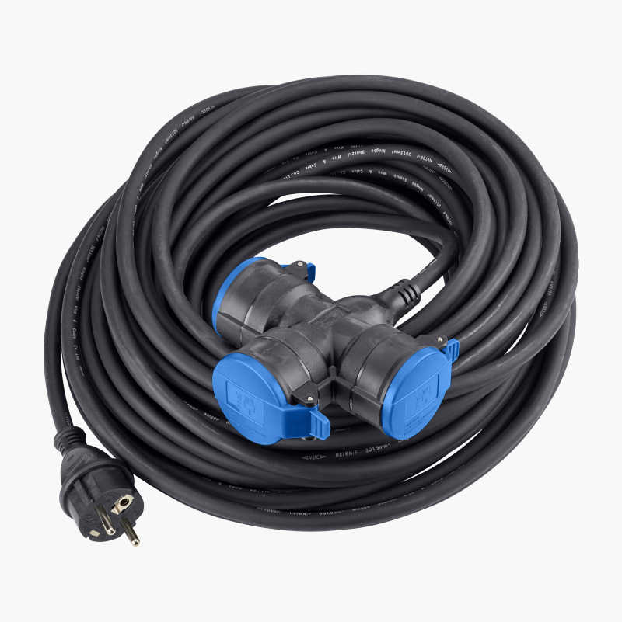
Earthed or non-earthed appliances?
Early forms of electrical supply and appliance wiring had only two wires; an active and a neutral. This is still common in many countries today.
In many countries, a third conductor commonly called the earth or ground is included in the wiring of buildings and in some appliances. This third conductor is connected to the earth contact within the power outlets which in turn are connected to the “earth bar” in the main switch board which in turn is connected to a metal stake inserted into the ground outside the building. This is called a protective earth The protective earth is a system to provide additional protection against electric shock. It is present in Class I appliances, extension leads and power boards.

Slide 10
Further Resources – Glossary of Electronic Terms (commercial)
https://hitech5.com/glossary/glossary-electronics-terminology-2/
https://www.jameco.com/Jameco/workshop/learning-center/glossary.html
http://www.electronicsandyou.com/electronics-dictionary.html

